Slide 1
Project 1
BY: Bsmah Al-Fayez.

Slide 2
Content:
Data Cleaning.
Property type.
Hosts.
Prices

Slide 3
Data cleaning
1. there were some columns that I thought were irrelevant to my analysis, so I decided to delete some of them and to keep some in a separate work sheet to go back to if needed.
2. I set ratings to a two decimals number for better view and accuracy.

Slide 4
Number of Listings by Property type

Slide 5
AVG rating for each property type.

Slide 6
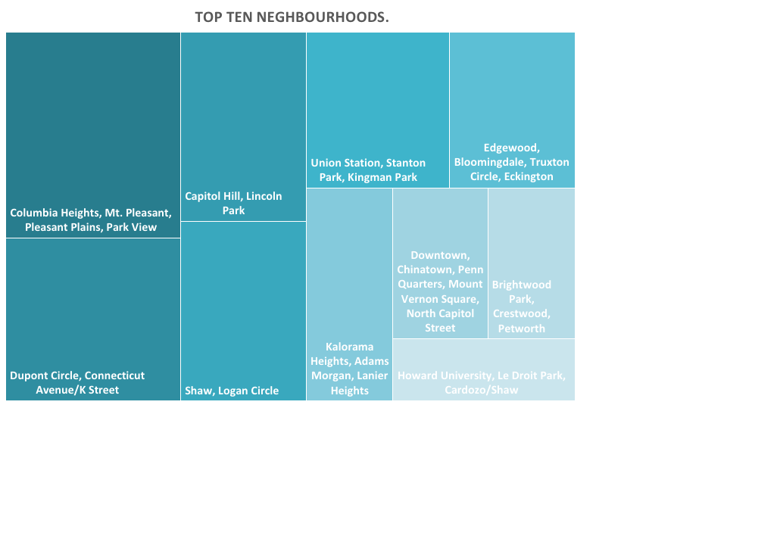
Top ten neighborhoods.

Slide 7
Top 10 neighborhoods ratings

Slide 8
Top 10 Hosts by number of properties

Slide 9
Top 20 Hosts AVG rating

Slide 10
What is the relationship between number of listing owned by one owner and rating? *hosts with more than 10 Listings.

Slide 11
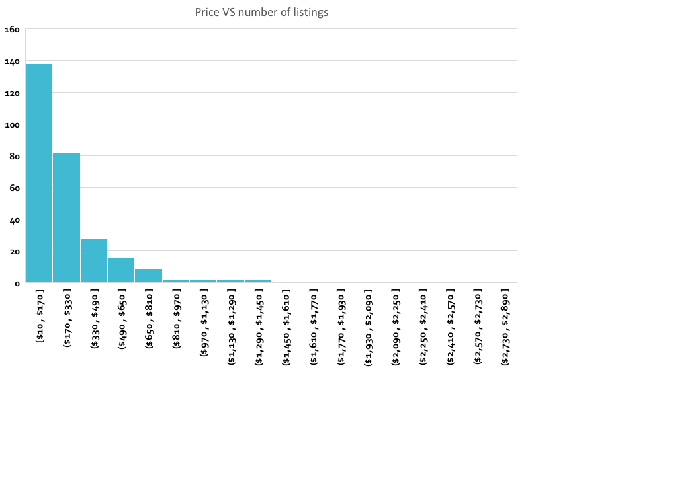
What is the AVG price per night?

Slide 12
Recommendations:
Invest in an apartment or a house.
Invest in one of the popular neighborhoods.
Invest with an experienced host with high ratings.
Invest in a property with a low cost per night.

